Slide 1
Project MAN
Team Adam
Cisco Geekfest Hackathon Austin, TX 2015

Slide 2
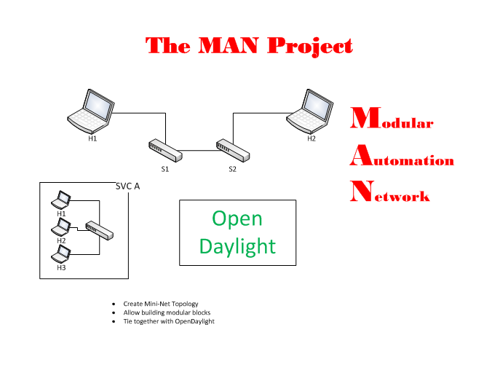
Overview

Slide 3
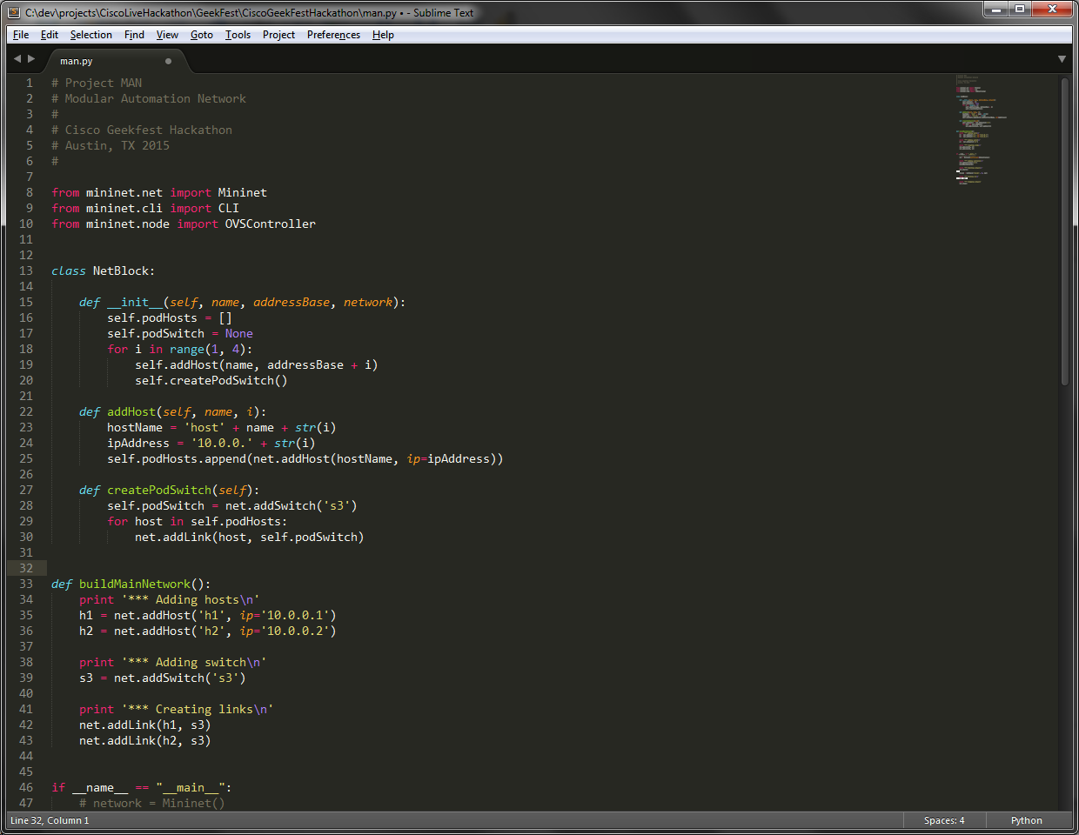
Code

Slide 4
Results
Build out a working topology
Integrate with ODL
Success was limited, but the experience was great

Slide 5
Team Members
Brett Kugler (brett.kugler@gdt.com)
Ramy Rahman (Ramy.Rahman@fishnetsecurity.com)
Jeff Sweet (jsweet@katalystng.com)

